Slide 1
Employee Data Analysis using Excel
STUDENT NAME : SENGAVI S H
REGISTER NO : 312209142
DEPARTMENT : COMMERCE
COLLEGE : ANNA ADARSH COLLEGE FOR WOMEN
NMID : C5456F2A878D778BB6846A0DCF5A7BA9

Slide 2
PROJECT TITLE
Employee Turnover Analysis using Pivot Table

Slide 3


AGENDA
Problem Statement
Project Overview
End Users
Our Solution and Proposition
Dataset Description
Modelling Approach
Results and Discussion
Conclusion
3/21/2024 Annual Review

Slide 4

PROBLEM STATEMENT Use Excel pivot tables to analyze employee turnover, focusing on trends and patterns. Look at turnover rates by department, job role, age, gender, and reasons for leaving. Create charts and reports to help understand the data and improve employee retention strategies.

Slide 5

PROJECT OVERVIEW This project involves using Excel pivot tables to analyze employee turnover data. We will examine turnover rates across different departments, job roles, age groups, and genders, and explore reasons for leaving. By creating pivot tables, charts, and reports, we aim to identify trends and patterns in employee departures. The insights gained will help in understanding turnover drivers and inform strategies to enhance employee retention and improve organizational practices.

Slide 6

WHO ARE THE END USERS 1.Hr manager 2.Recruitment team 3.Department heads 4.Executive and senior leadership Data analysts

Slide 7

OUR SOLUTION AND ITS VALUE PROPOSITION FILTERING-Removing missing values CONDITIONAL FORMATTING-Blanks PIVOT TABLE-Summary of employee turnover FORMULA-IFS LINE CHART-Final report

Slide 8
Dataset Description On Kaggle, an employee dataset typically includes various attributes such as Employee ID, Name, Age, Gender, Department, Job Title, Salary, Hire Date, Years at Company, Performance Rating, Education Level, Location, and Employment Status. This data can be used to analyze employee retention, salary trends, and job satisfaction. For example, you might explore correlations between salary and performance ratings, or identify patterns in attrition across different departments. Such insights help in evaluating and improving employee management and retention strategies.

Slide 9

THE "WOW" IN OUR SOLUTION In our employee turnover analysis using excel pivot tables the “wow” factor lies in the powerful insights and visualisations we can generate with just a few click. By leveraging pivot tables, we can quickly summarise complex data to reveal patterns such as turnover rates by department, performance trends, and correlations between tenure and attention. Customisable filters and slicers allow us to drill down into specific segments, providing a clear view of factors influencing employee retention.
3/21/2024 Annual Review
9

Slide 10
MODELLING
Step 1: Prepare Your DataEnsure your dataset is well-structured in a table format, with columns such as EmpID, EmployeeStatus, EmployeeType, DepartmentType, Division, etc.Each row should represent a unique record for an employee.
Step 2: Insert a Pivot TableSelect your data range.Go to Insert > PivotTable.Choose where you want the PivotTable report to be placed (either in a new worksheet or the existing one).
Step 3: Set Up Pivot Table FieldsRows: Drag DepartmentType and Division into the Rows area. This will allow you to break down the data by departments and their corresponding divisions.Columns: Drag EmployeeStatus and EmployeeType into the Columns area. This will help you compare data based on employee status and type.Values: Drag EmpID into the Values area. Set it to count if it's not automatically recognized as a count field (right-click on the field in Values, then select "Value Field Settings" and choose "Count").
Step 4: Create the Pivot ChartWith your PivotTable still selected, go to Insert > Line Chart (or any chart type you prefer that suits your analysis).This will generate a line chart based on the Pivot Table data.
10

Slide 11
MODELLING
Step 5: Customize the ChartAdjust the axis titles, chart title, and labels. In your case, the chart title might be something like "Using Pivot Tables for Employee Turnover Analysis."You may need to format the chart's axis to better display the data (e.g., adjusting the minimum and maximum values, changing the number format).
Step 6: Filter the DataUse the filters at the top of the PivotTable to control which data is displayed. For example, filter by EmployeeStatus or EmployeeType to focus on specific groups.You can add slicers for a more interactive experience by going to Analyze > Insert Slicer and choosing fields such as EmployeeStatus and EmployeeType.
Step 7: Analyze the ResultsLook at the trends and patterns in the line chart. For example, the peaks might indicate a high turnover in certain departments.Compare how different divisions and employee types contribute to the turnover rate.
Step 8: Update the DataIf your source data is updated, simply refresh the Pivot Table and the chart will update automatically to reflect the latest information.To refresh, click anywhere in the Pivot Table and go to Analyze > Refresh.This process will help you create a comprehensive analysis of employee turnover using Pivot Tables and line charts in Excel.

Slide 12
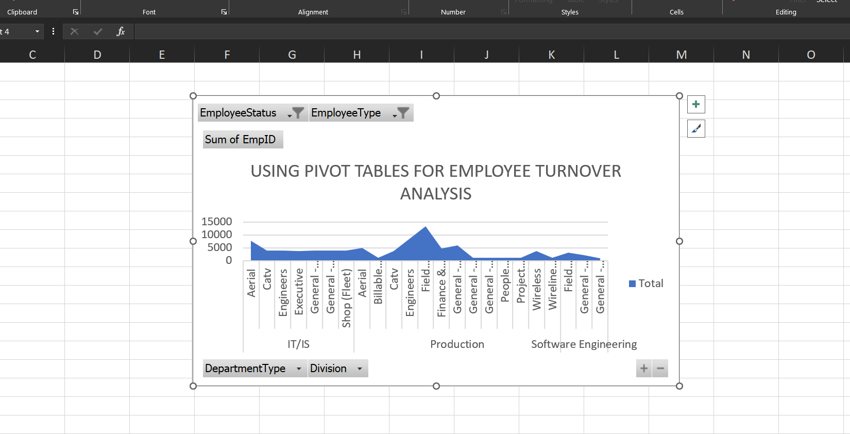
RESULTS
12

Slide 13
CONCLUSION The line chart derived from the pivot table offers a clear visualization of employee turnover trends over the analyzed period. It reveals fluctuations in turnover rates, highlighting specific peaks and troughs that suggest periods of increased or decreased employee attrition. Notable spikes indicate times of significant turnover, which may correlate with organizational changes, market conditions, or management issues, warranting further investigation. Conversely, periods of lower turnover reflect potentially effective retention strategies or stable organizational conditions. By analyzing these trends, the company can gain actionable insights into the causes of turnover and success factors in retaining employees, allowing for targeted improvements in employee engagement, recruitment strategies, and overall retention efforts.

